Slide 1
Critical Appraisal Institute for Librarians (CAIFL)
Presented to SWHSL, March 2021
Liz Suelzer, MCW Libraires esuelzer@mcw.edu

Slide 2
Today’s Presentation
Overview of CAIFL
Understanding Odds Ratios & Risk Ratios

Slide 3
CAIL Goal & Objectives
To develop librarian’s critical appraisal skills including enhanced understanding of research design, biomedical statistics, and clinical reasoning to apply knowledge in teaching target populations.
Describe and analyze study methodologies used in clinical research.
Define and critique biostatistical concepts used to report the results of clinical research studies.
Critically appraise biomedical articles including an understanding of the methodology, sources of bias, and the results.
Teach critical appraisal with confidence.

Slide 4
CAIFL Content & Classes
2 plenary sessions lead by clinical faculty
Focus on what medical students need to know about critical appraisal
6 weekly sessions
2 hour sessions
2-4 hours of homework – videos, articles, readings, worksheets
1 educational presentation
1 journal club presentation

Slide 5
Okay, that sounds great, but…
Plenary Session 1: Why EBM? Andy Coyle, MD
I’ll naturally learn the right ways to diagnose and manage my patients as I proceed through my training.
I’ll learn EBM from other practicing physicians who are knowledgeable about this sort of stuff.
I’ll read the primary literature. And I’ll know the studies are well done and can be trusted since they got published in a peer-reviewed medical journal.
I’ll only read stuff from the most reputable journals with the highest impact factors.
I’ll rely on others to aggregate the data for me. Uptodate and Dynamed have tons of great evidence-based information available.
I’ll just read everything relevant to my field. I signed up for eTOC from the journals relevant to my field and will read those as they come into my email inbox.
EBM / Critical Appraisal is an essential SKILL for a practicing clinician –
one that you need to be able to turn on for critical decisions

Slide 6
CAIFL - Details
Sponsored by the New York Medical College
January 26 – March 16, 2021
Fully online course
35 MLA CE credits
$450 fee – Thank you SWHSL!
6 librarian instructors, 2 clinical instructors
Small group sessions, 9-10 librarians/session

Slide 7
CAIFL Topics
Week 1: Critical Appraisal & Clinical Study Designs – Basics & Biases
Week 2: Foundational Stats: Descriptive & Inferential Statistics, Hypothesis Testing, Confounding, causation, confidence intervals, p values
Week 3: Common Measures of Association in Biomedical Studies: Harm & Therapy Studies, Odds ratio, risk ratio, relative risk, absolute risk reduction
Week 4: Appraising Diagnostic Tool and Screening Studies, Sensitivity, specificity, likelihood ratios, predictive values
Week 5: Prognosis Studies and Systematic Reviews, Survival charts, forest plot, funnel plot
Week 6: Journal Club

Slide 8
Odds Ratio | Relative Risk
Liz Suelzer, MCW Libraires esuelzer@mcw.edu

Slide 9
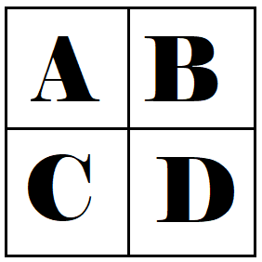
Odds Ratio | Risk Ratio/Relative Risk
A measure of how strongly an event is associated with exposure. | Ratio of the risk of an event in the two groups
Odds: probability of occurrence of an event/probability of the event not occurring | Risk: chance of the outcome of interest/all possible outcomes
(A / C) (B / D) | A / (A + B) C / (C + D)
OR = 1: no difference in event & exposure | RR = 1: no difference in outcome & exposure
OR < 1: lower odds of association between the exposure and outcome. Exposure us protective. | RR < 1: risk of the outcome is decreased by the exposure. Favors intervention/exposure.
OR > 1: higher odds of association between the exposure and outcome. Exposure is harmful. | RR > 1: risk of the outcome is increased by the exposure. Favors control.

Slide 10
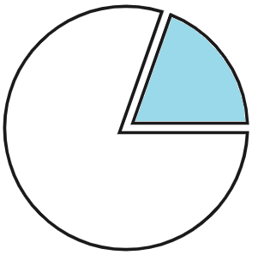
Odds
Risk/Probability
4
6
4
10
= .67
4
196
4
200
= .4
.02
Notes:
Risk of incidence of people drinking the miracle tea and getting sick is 4/10 or .4 . For the odds, we are looking at the number of people who get sick vs. the number who don’t get sick. This number is .67 or 2/3.
Difference – denominator – all cases vs. comparison cases.
Things to note – Risk can never be greater than 1. The biggest number you can put in the numerator is equal to the denominator. Odds can be infinitely large.
Also, for rare diseases where the number of incidents is very low, the risk and odds numbers get very close to each other.

Slide 11
2 x 2 Table
 | Event/ Disease/ Outcome | No Event/ No Disease/ No Outcome | Total Participants
Treatment/ Experimental/ Exposed Group | A | B | (A + B)
Control/ Placebo/ Unexposed Group | C | D | (C + D)
Total Outcomes | (A + C) | (B + D)

Slide 12
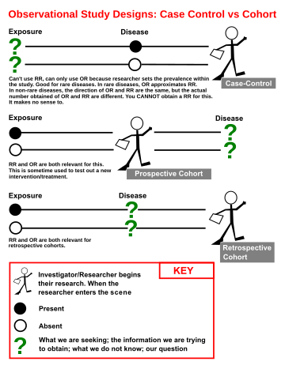
Case Control
Cohort

Slide 13
Case Control
Cohort
Start w/ Outcome
Start w/ Exposure
Look for Exposure
Look for Outcome
Time
Time
Notes:
Miracle tea to prevent aging & stomach ulcers.

Slide 14
Case Control
Start w/ Outcome
Look for Exposure
Time

Slide 15
Case Control
(A / C) (B / D)
Odds Ratio
Start w/ Outcome
 | 5
 | 5
 |  | 3
 |  | 7
 | Sick | ⌀
Tea
⌀
Totals | 10 | 10
Odds of drinking tea & getting sick:
5 / 5 = 1
Odds of drinking tea & not sick:
3 / 7 = .42
Odds Ratio
1 / .42 = 2.33
Look for Exposure
Time
Notes:
How many sick people drank the tea? 5. Odds of drinking the tea and getting sick is 1. Odds of drinking tea and not getting sick is 3/7.
In this instance, calculating risk wouldn’t make sense. We can look at the risk of drinking tea & ending up with a being sick, because we know how many total people are sick. But we don’t know the total exposed group to make an accurate calculation.

Slide 16
Cohort
Start w/ Exposure
Look for Outcome
Time

Slide 17
Cohort
Start w/ Exposure
Look for Outcome
Time

Slide 18
Cohort
A / (A + B) C / (C + D)
Risk Ratio
Start w/ Exposure
 | 6 | 4
 | Sick | ⌀ | Totals
Tea |  |  | 10
⌀ |  |  | 10
 | 2 | 8
Risk of getting sick after tea
2 / 10= .2
Risk of getting sick & not drinking tea:
6 / 10 = .6
2/10
6/10
= .33
Look for Outcome
Time

Slide 19
Cohort
A / (A + B) C / (C + D)
Risk Ratio
Start w/ Exposure
 | Sick | ⌀ | Totals
Tea |  |  | 10
⌀ |  |  | 10
 | 6 | 4
 | 2 | 8
Risk of getting sick after tea
6 / 10= .6
Risk of getting sick & not drinking tea:
2 / 10 = .2
6/10
2/10
= 3
Look for Outcome
Time

Slide 20
On to the Literature!

Slide 21
Varenicline for smoking cessation in people with schizophrenia: a double blind randomized pilot study.
 | Relapsed | Abstained
Varenicline |  |  | N=4
Placebo |  |  | N=4
Relative Risk
1 / (1 + 3)
4 / (4 + 0)
= .75
Weiner E, Buchholz A, Coffay A, Liu F, McMahon RP, Buchanan RW, Kelly DL. Varenicline for smoking cessation in people with schizophrenia: a double blind randomized pilot study. Schizophr Res. 2011 Jun;129(1):94-5. doi: 10.1016/j.schres.2011.02.003. Epub 2011 Mar 4. PMID: 21376537; PMCID: PMC3691956.
Notes:
Would we use relative risk or odds ratio for this study to measure the benefit of varenicline over the placebo?
RR because we are looking forward in time. In the varenicline group: relapsed = 1, abstained = 3, in the placebo group, 4 relapsed, 0 abstained.
As a side note – do you remember what it means if Relative risk is less than 1?

Slide 22
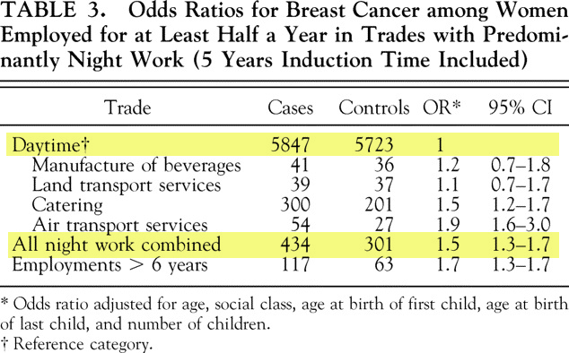
Increased Breast Cancer Risk among Women Who Work Predominantly at Night
 | Breast Cancer | ⌀
Night work |  |  | N=6281
Day work |  |  | N=6024
Odds Ratio
434 / 5847 434 * 5723
301 / 5723 301 * 5847
= 1.41
Hansen J. Increased breast cancer risk among women who work predominantly at night. Epidemiology. 2001 Jan;12(1):74-7. doi: 10.1097/00001648-200101000-00013. PMID: 11138824.
Notes:
Started with a group of 7035 breast cancer patients w/ employment history identified in Danish Cancer Registry. They matched the 7035 patients with 7035 additional people that were chosen from the Central Population Registry, and the control group didn’t have cancer.
Of these 7035 people w/ cancer, 754 were excluded because their employment was mixed between night & day, and 1011 controls were excluded for the same reason. If you add daytime cases + all night work cases, you will the N.

Slide 23
Sources consulted:
https://www.ncbi.nlm.nih.gov/pmc/articles/PMC4640017/
https://www.youtube.com/watch?v=hOtoV2Kjb0o
https://www.ncbi.nlm.nih.gov/books/NBK430824
https://www.ncbi.nlm.nih.gov/books/NBK431098/
Notes:
Be aware:
Odds ratio will overestimate the risk if the disease is more common

