Slide 1
Supporting Clinical Care: An Evidence Based Institute for Medical Librarians

Slide 2
Overview
3 day workshop
27 participants
6 faculty + 2 teaching fellows
University of Colorado Anschutz Medical Campus
20 MLA CE credits

Slide 3
Learning Objectives
Identify and explain the concepts, issues and process of evidence-based clinical practice (EBCP)
Recognize different types of study designs and understand their strengths and limitations
Create well-built, answerable clinical questions
Use clinical questions to find the best evidence in the literature

Slide 4
Learning Objectives
Identify and explain the criteria for judging the internal validity of randomized controlled trials, systematic reviews, and qualitative studies
Identify roles that librarians can undertake in providing EBCP training and support to health care professionals.

Slide 5
Why I Attended
New to the medical librarian field
Learning EBP in bits and pieces
Sounded challenging

Slide 6
Daily Schedule 8:30-5
Large group
Snacks
Small group
Lunch
Small or large group
More snacks
Small group
Notes:
Concept introduced in large group then discussed further with small group with practice exercises
Small group was the same all days. And would break into even smaller groups. 2 instructors.

Slide 7
What I Learned (or Learned Better)
Study design
Bias in RCTs
2x2 tables – relative risk (lots of math!)
Qualitative studies
How to read a forest plot
Bias in systematic reviews
Notes:
Review of study design and advantages and disadvantages, Practiced identified study design from abstracts.
Bias: concealed allocation, blinding, intention to treat, selection, etc. Practiced identifying in published studies
2x2 – EER, CER
SR – draw forest plot exercise

Slide 9
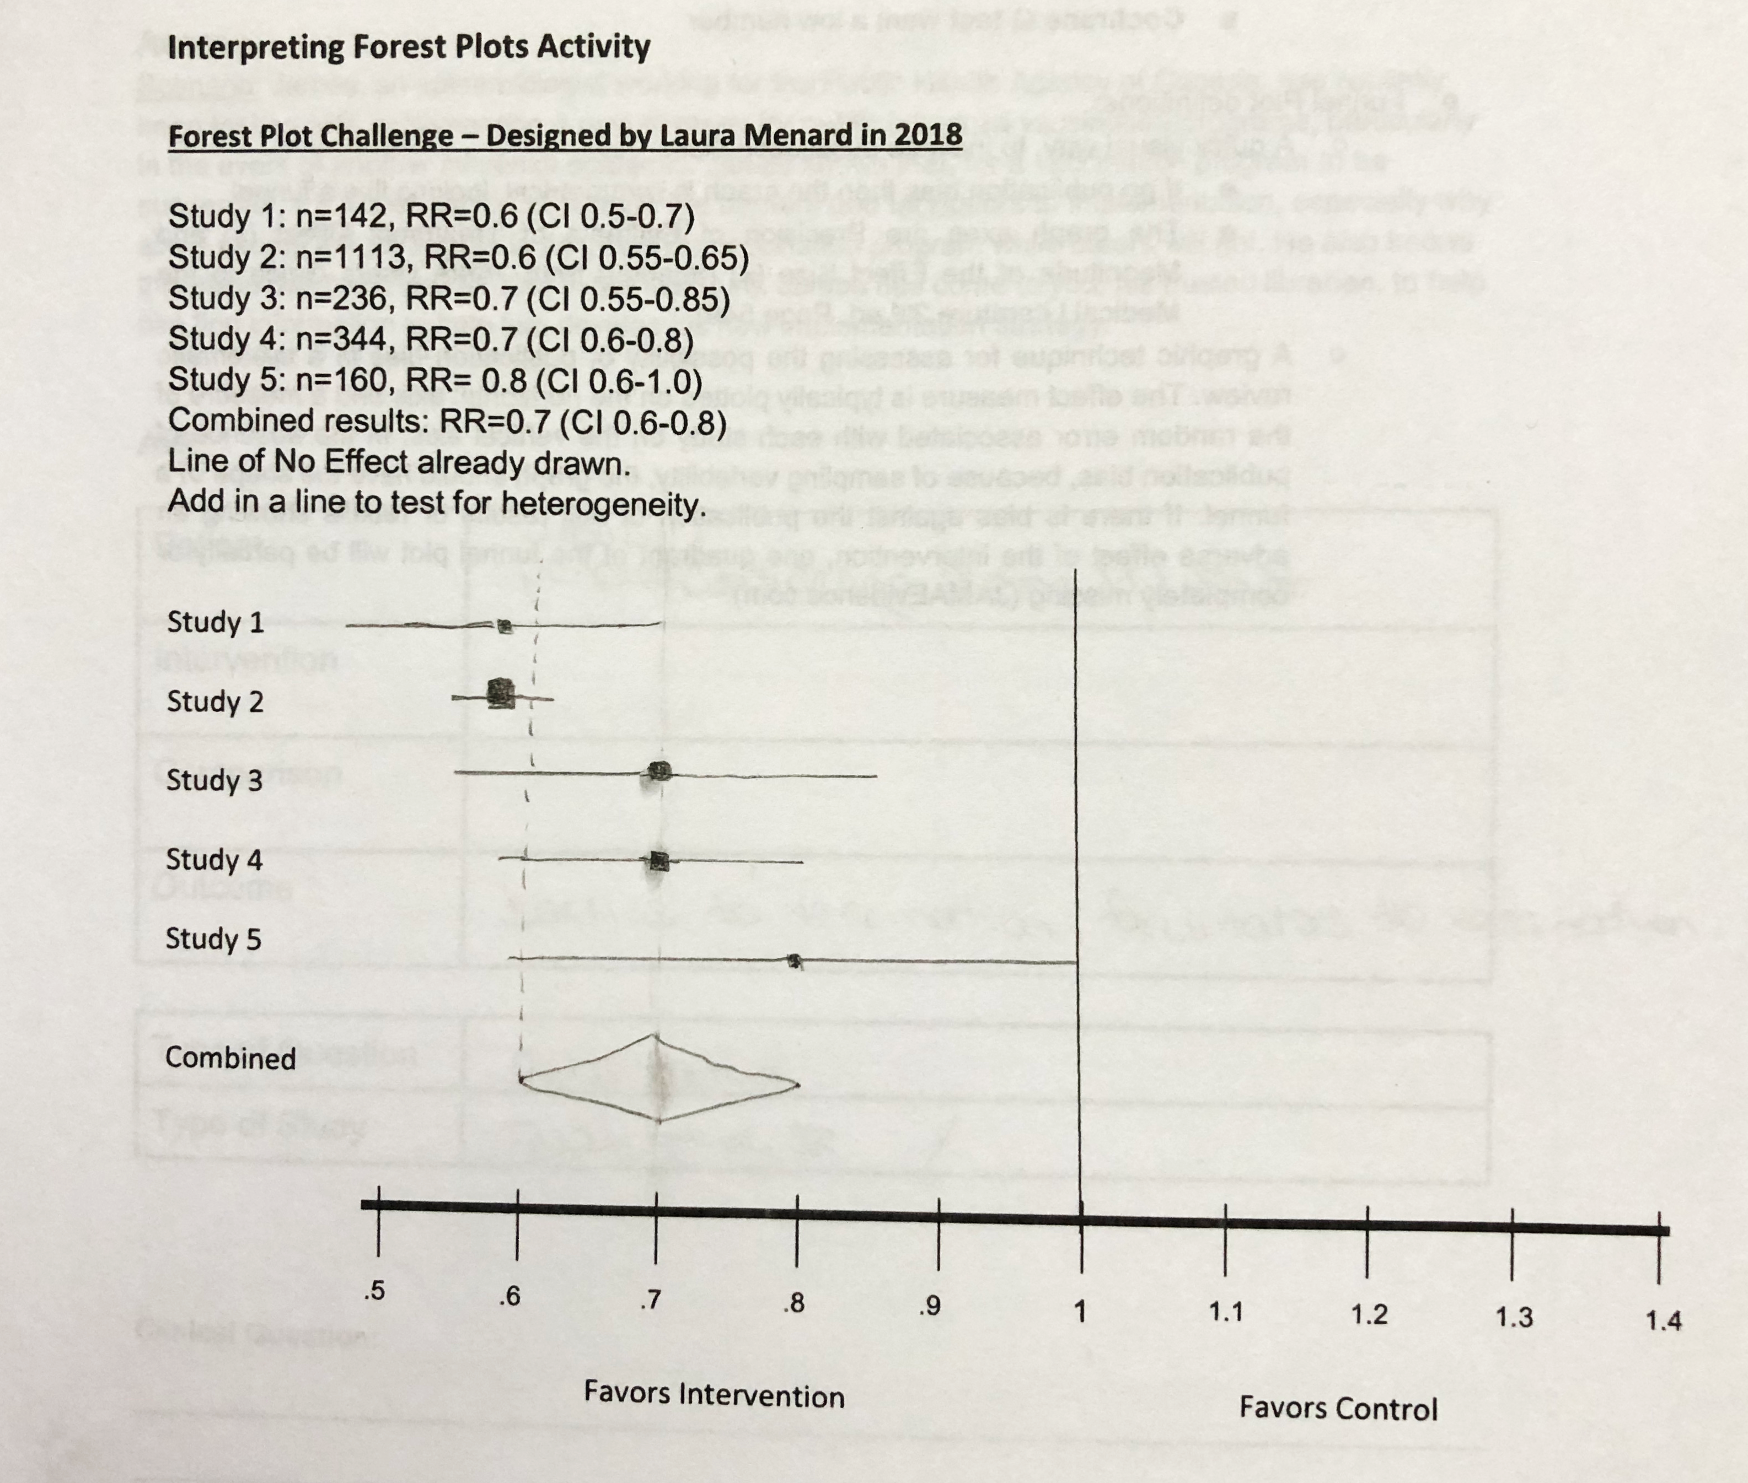

Slide 10
Recommend for
New medical librarians
Teaching EBP or critical appraisal
Notes:
Review of study design and advantages and disadvantages, Practiced identified study design from abstracts.
Bias: concealed allocation, blinding, intention to treat, selection, etc.
2x2 – EER, CER
SR – draw forest plot exercise

Slide 11
Thank you SWHSL!

